Slide 1

Reporting and Analyzing Cash and Internal Controls
6
Chapter
UAA – ACCT 201 Principles of Financial Accounting Dr. Fred Barbee

Slide 2
Day #1
IS FUN!
ACCOUNTING
ACCT 201 ACCT 201 ACCT 201

Slide 3
Chapter 6 - Day 1 - Agenda
Topic | LO | Read | HW
Internal Control | C1, C2 | 250-254 | QS1, QS3, E1, E3, P1A
Control of Costs | C3, P1, 2, 3, 4 | 254-262 | E2, E4, E10
No Homework Due Today!

Slide 4
Reporting and Analyzing Cash and Internal Controls
6
Chapter
Internal Control

Slide 5

Internal Control – All Policies and Procedures Used to . . .
Protect assets.
Ensure reliable accounting.
Promote efficient operations.
Urge adherence to company policies.

Slide 6

Principles of Internal Control
Establish responsibilities.
Maintain adequate records.
Insure assets and bond employees.

Slide 7
Principles of Internal Control
Separate recordkeeping and custody over assets
Divide responsibility for related transactions.

Slide 8
Principles of Internal Control
Apply technological controls.
Perform regular and independent reviews.

Slide 9

Technology and Internal Control
Reduced
Processing
Errors
More
Extensive Testing
of Records
Limited
Evidence of
Processing
Crucial
Separation of
Duties

Slide 10


Limitations of Internal Control
Human Error
Human Fraud
Negligence
Fatigue
Misjudgment
Confusion
Intent to
defeat internal
controls for
personal gain

Slide 11

Limitations of Internal Control
The costs of internal controls
must not exceed their benefits.
Benefits
Costs

Slide 12
Reporting and Analyzing Cash and Internal Controls
6
Chapter
Control of Cash

Slide 13


Cash, Cash Equivalents, and Liquidity
Cash
  Currency, coins and amounts on deposit in bank account, checking accounts, and some savings accounts.

Slide 14

Cash, Cash Equivalents, and Liquidity
Cash Equivalents are short-term, highly liquid investments that are:
  Readily convertible to a known cash amount.
  Close to maturity date and not sensitive to interest rate changes.

Slide 15



Cash, Cash Equivalents, and Liquidity
Liquidity
  How easily an asset can be converted into another asset or be used in paying for services or obligations.
Inventory
Cash

Slide 16
Control of Cash
Segregate handling of cash from recordkeeping of cash.
Cash receipts are promptly (daily) deposited in a bank.
Cash disbursements are made by check.

Slide 17
Control of Cash Receipts
Over-the-Counter Cash Receipts
  Cash register with locked-in record of transactions.
  Compare cash register record with cash reported.

Slide 18

Control of Cash Receipts
Cash Receipts By Mail
  Two people open the mail.
    Money to cashier’s office
    List to accounting dept.
    Copy of list filed

Slide 19
Control of Cash Disbursements
All expenditures made by check. The only exception is for small payments from petty cash.
Separate authorization, check signing and recordkeeping duties.
Apply a voucher system.

Slide 20
A Voucher System of Control
Establishes procedures for:
  Accepting obligations resulting in cash disbursements.
  Verifying, approving and recording obligations.
  Issuing checks for payment of verified, approved and recorded obligations.

Slide 21
A Voucher System of Control
Establishes procedures for:
  Requiring obligations be recorded when incurred.
  Treating each purchase as an independent transaction.

Slide 22



Voucher System of Control
Cashier’s Office
Check
Supplier (Vendor)
Accounting Dept.
Invoice Approval
Cashier’s Office
Receiving Dept.
Receiving Report
Accounting, Requesting,
Purchasing Depts.
Supplier (Vendor)
Invoice
Accounting Dept.
Purchasing Dept.
Purchase Order
Supplier (Vendor)
Requesting Dept.
Purchase Requisition
Purchasing and
Accounting Depts.
Voucher

Slide 23
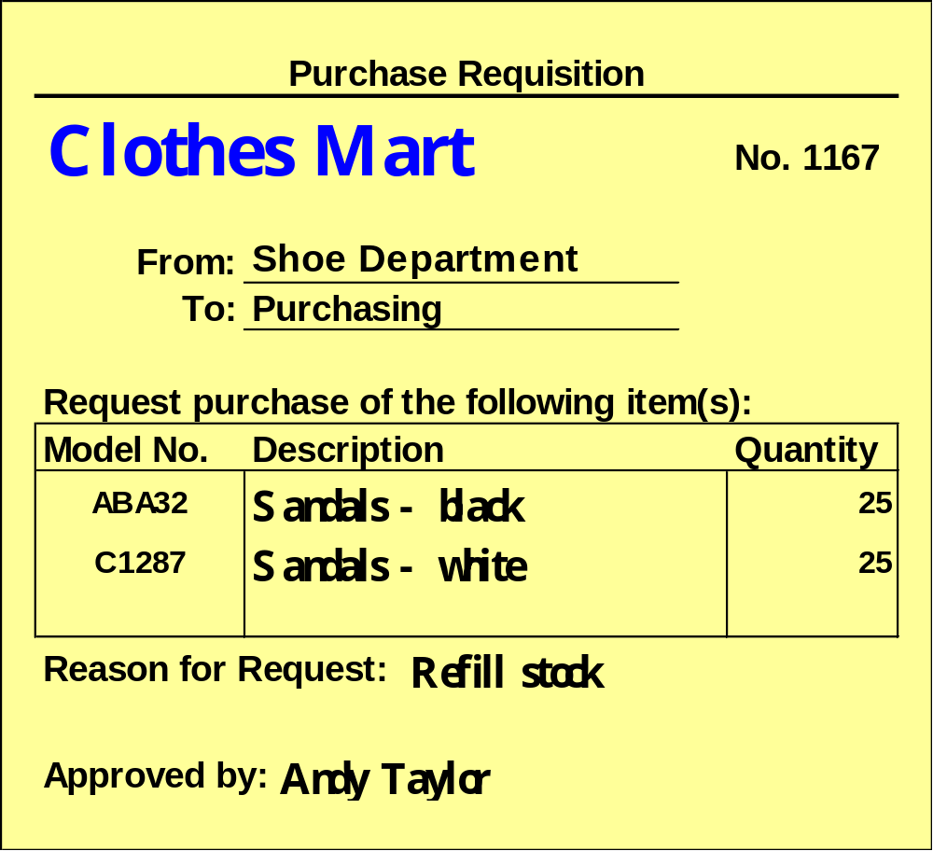
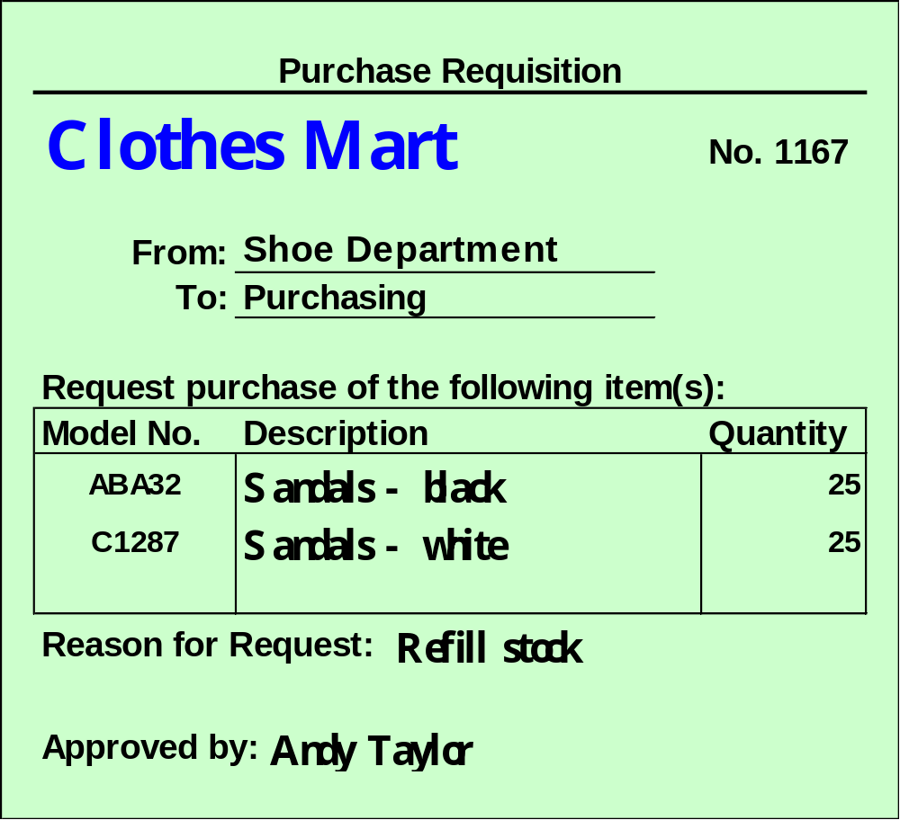
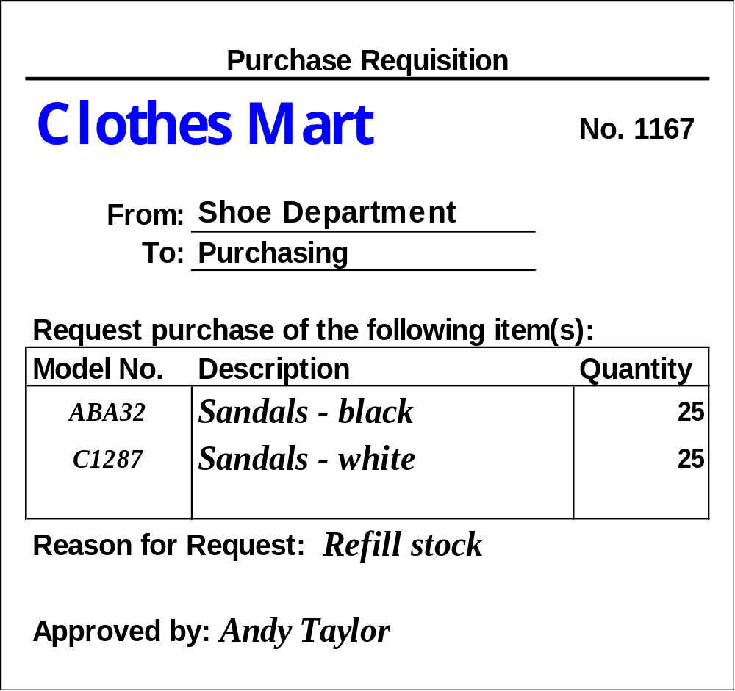
Copy 2
Purchasing
Copy 1
Accounting
One copy
of purchase
requisition
used to
prepare the
voucher.
Requesting
Department

Slide 24
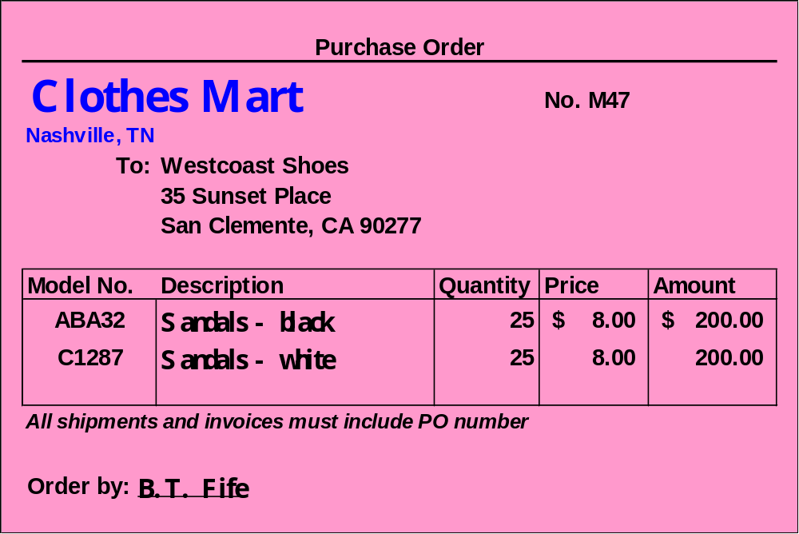
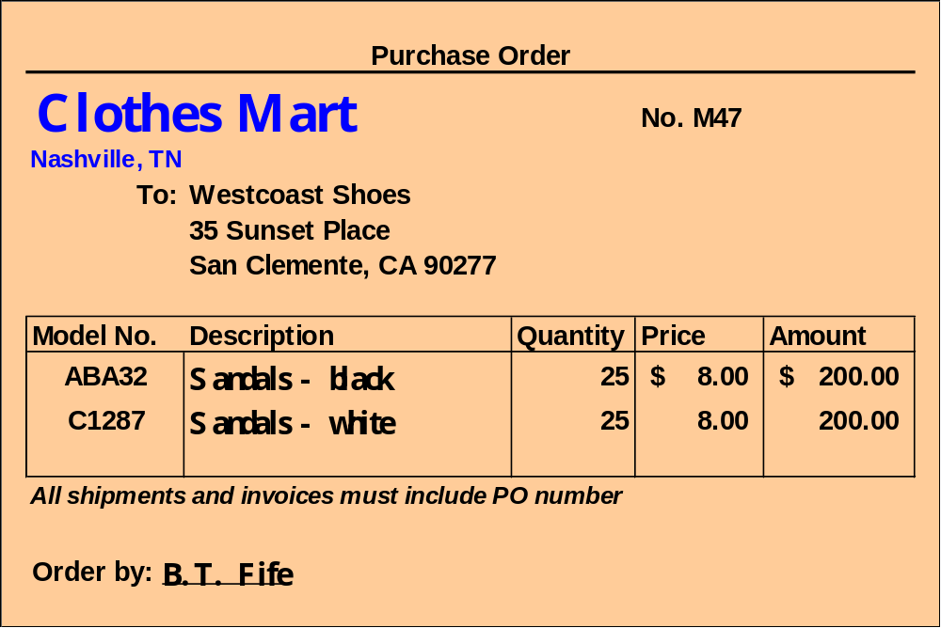
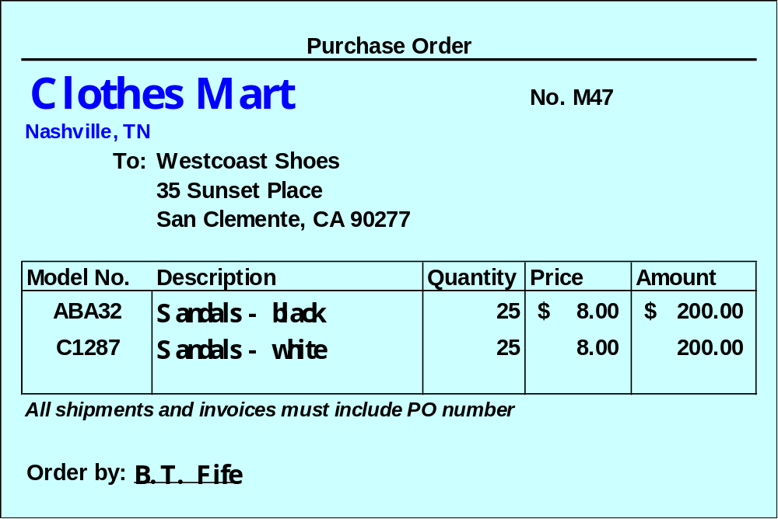
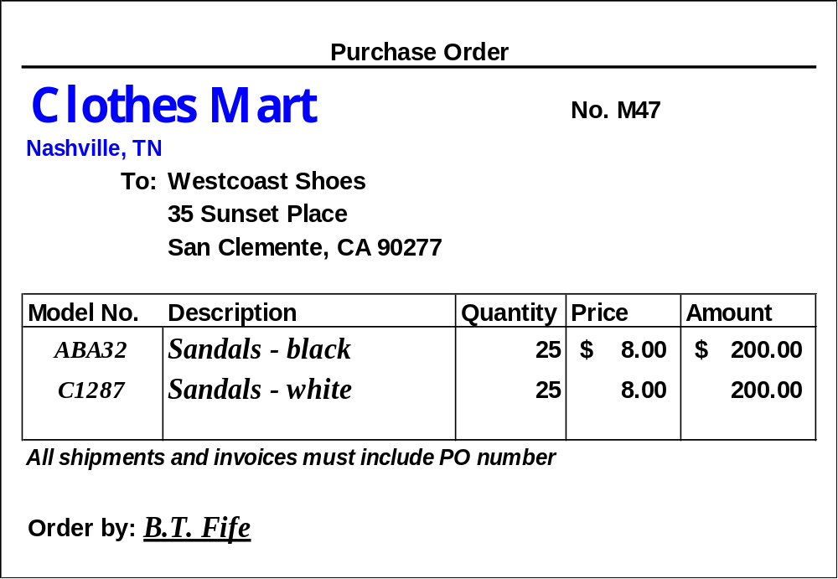
Requesting Dept.
Copy 3
Accounting
Copy 2
Vendor
Copy 1
Retained in Purchasing

Slide 25
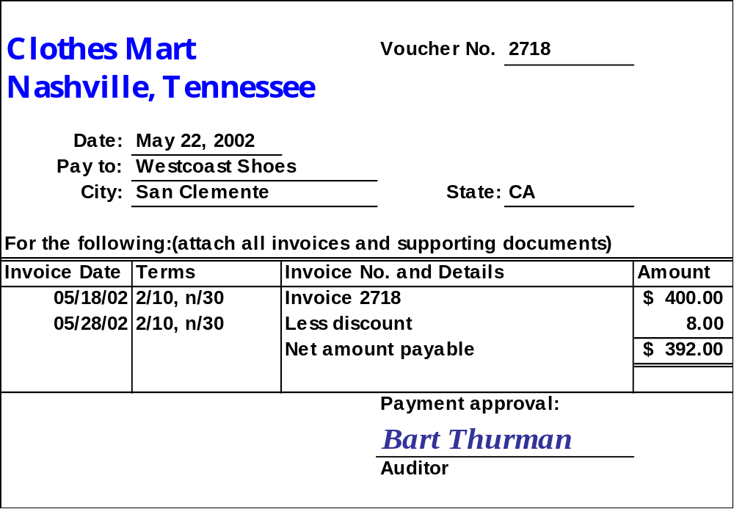

Inside of a Voucher

Slide 26
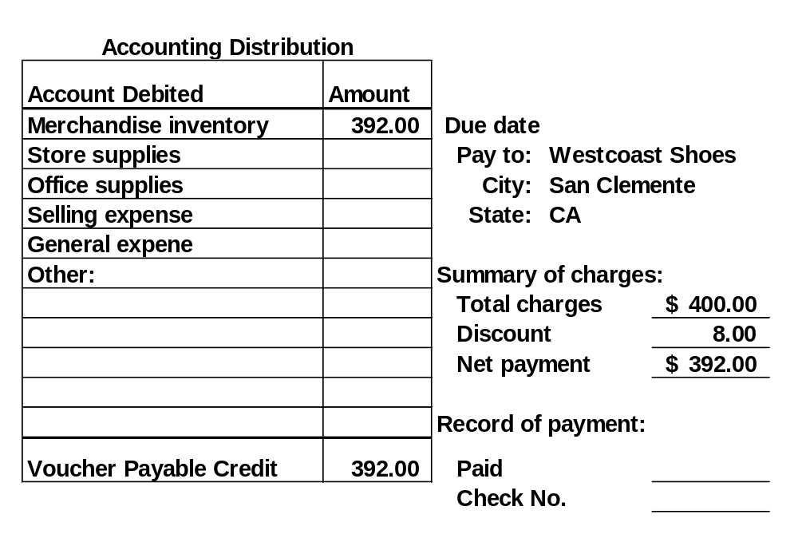
Outside of a Voucher

Slide 27

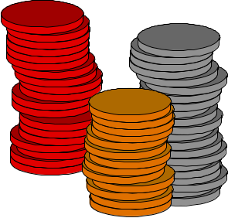
Petty Cash System of Control
Small payments required in most companies for items such as postage, courier fees, repairs and supplies.

Slide 28


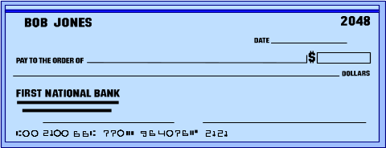
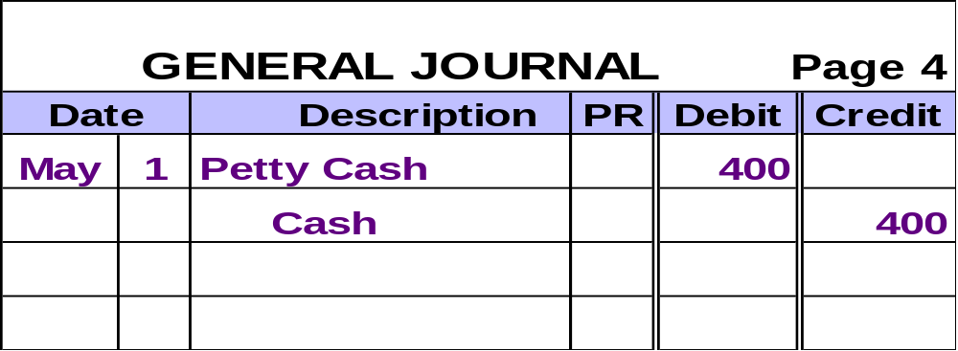
Operating a Petty Cash Fund
Petty Cashier
Treasurer and
Accountant
Petty Cashier

Slide 29

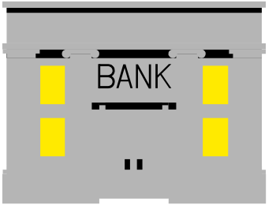
Operating a Petty Cash Fund
Petty Cashier
Petty Cashier

Slide 30


Operating a Petty Cash Fund
Receipts
Petty Cashier
Petty Cashier
34¢
34¢
Stamps
Courier
Stamps
Courier

Slide 31
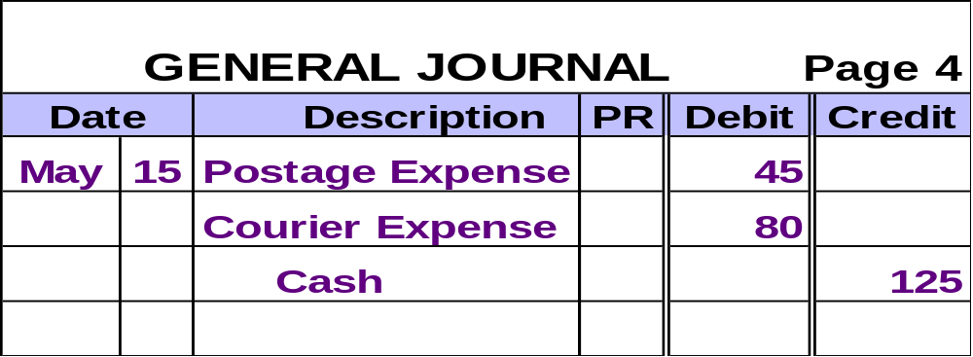
Operating a Petty Cash Fund
Receipts
$125
To reimburse
petty cash fund
Treasurer and
Accountant
Petty Cashier
We use a Cash
Over and Short
account if needed.

Slide 32
Petty Cash Example
Tension Co. maintains a petty cash fund of $400. The following summary information was taken from petty cash vouchers for July:
  Travel Expenses $79.30
  Customer Business Lunches 93.42
  Express Mail Postage 55.00
  Miscellaneous Office Supplies 32.48
Let’s look at replenishing the fund if the balance on July 31 was $137.80.

Slide 33

Petty Cash Example
What amount of cash will be required to replenish the petty cash fund?
a. $260.20
b. $262.20
c. $139.80
d. $137.80

Slide 34
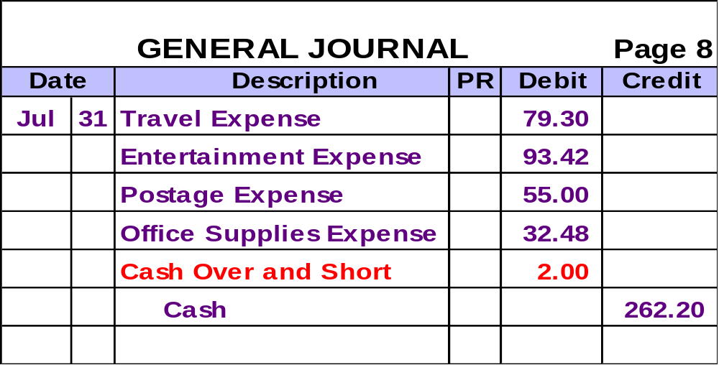
Petty Cash Example
The journal entry to replenish the petty cash fund is:

Slide 35
Reporting and Analyzing Cash and Internal Controls
6
Chapter
Control of Purchases Discounts

Slide 36
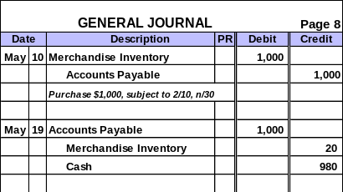
Control of Purchase Discounts
Previously we have recorded purchases of Merchandise Inventory at the gross amount. Discounts were not recognized until payment was made.

Slide 37
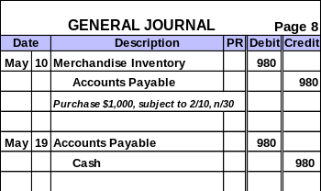
Control of Purchase Discounts
As an alternative, we may record the purchase net of any discount. We assume that all discounts will be taken.

Slide 38
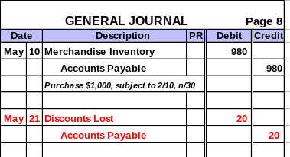
Control of Purchase Discounts
When we use the net method, attention is drawn when available discounts are not taken.
Discounts Lost is an
expense account and is included
on the income statement.

